Slide 1
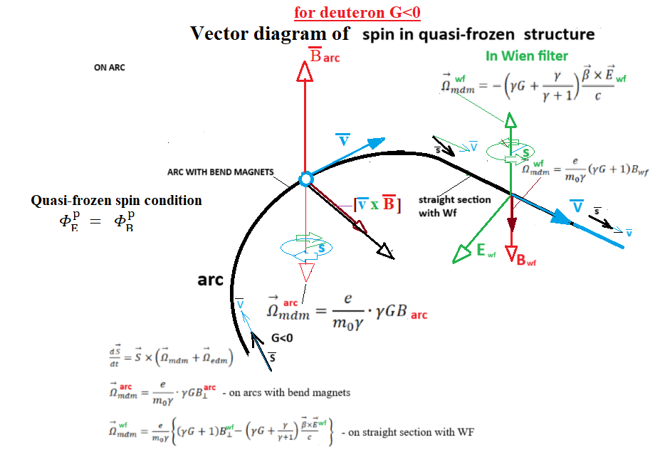

Slide 2














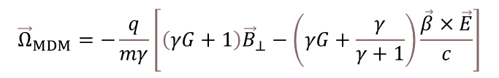





General equations
Deuteron case $G<0$
Orbital
${\vec{ω}}_{p}^{B}=−\frac{q}{mγ}{γG\vec{B}}_{⊥}=−\frac{q}{mγ}{γ∙−\left|G_{d}\right|\vec{B}}_{⊥}=$ $\frac{q}{mγ}{γ∙\left|G_{d}\right|\vec{B}}_{⊥}$
${\vec{Ω}}_{MDM}^{E}$= $−\frac{q}{mγ}$ $\left[−\left(γG+\frac{γ}{γ+1}\right)\frac{\vec{β}×\vec{E}}{c}\right]$
$${\vec{F}}_{L} ={\vec{Ω}}_{p}^{B}×\vec{p}$$
$${\vec{Ω}}_{p}^{B}=−\frac{q}{mγ}{\vec{B}}_{⊥}$$
$${\vec{B}}_{arc}$$
$$\vec{p}$$
Spin MDM rotation
$$\vec{s}$$
$${\vec{B}}_{WF}$$
$$\vec{E}$$
$$\vec{p}$$
$$\frac{d\vec{S}}{dt}=\left({\vec{Ω}}_{MDM}+{\vec{Ω}}_{EDM}\right)×\vec{S},$$
arc
$${\vec{Ω}}_{p}^{B}$$
$${\vec{Ω}}_{MDM}=−\frac{q}{mγ}\left[\left(γG+1\right){\vec{B}}_{⊥}−\left(γG+\frac{γ}{γ+1}\right)\frac{\vec{β}×\vec{E}}{c}\right]$$
$$\vec{s}$$
$$\vec{p}$$
Relative spin
${\vec{Ω}}_{MDM}^{B_{⊥}}$= $−\frac{q}{mγ}$ $\left(γG+1\right){\vec{B}}_{⊥}$
$$\vec{p}$$
$${\vec{ω}}_{p}^{B}={\vec{Ω}}_{MDM}^{B_{⊥}}−{\vec{Ω}}_{p}^{B}=−\frac{q}{mγ}{γG\vec{B}}_{⊥}$$
$$\vec{s}$$

Slide 3








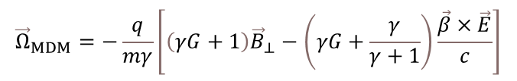


General equations
Proton case $G>0$
Orbital
${\vec{Ω}}_{MDM}^{B_{⊥}}$= $−\frac{q}{mγ}$ $\left(γG+1\right){\vec{B}}_{⊥}$
$${\vec{F}}_{L} ={\vec{Ω}}_{p}^{B}×\vec{p}$$
$${\vec{Ω}}_{p}^{B}=−\frac{q}{mγ}{\vec{B}}_{⊥}$$
$${\vec{B}}_{arc}$$
$$\vec{p}$$
Spin MDM rotation
$$\vec{p}$$
$$\frac{d\vec{S}}{dt}=\left({\vec{Ω}}_{MDM}+{\vec{Ω}}_{EDM}\right)×\vec{S},$$
arc
$$\vec{s}$$
$${\vec{Ω}}_{p}^{B}$$
$${\vec{Ω}}_{MDM}=−\frac{q}{mγ}\left[\left(γG+1\right){\vec{B}}_{⊥}−\left(γG+\frac{γ}{γ+1}\right)\frac{\vec{β}×\vec{E}}{c}\right]$$
$$\vec{E}$$
$${\vec{B}}_{WF}$$
$$\vec{s}$$
$$\vec{p}$$
$${\vec{ω}}_{p}^{B}=−\frac{q}{mγ}{γG\vec{B}}_{⊥}=−\frac{q}{mγ}{γ∙\left|G_{p}\right|\vec{B}}_{⊥}=−\frac{q}{mγ}{γ∙\left|G_{p}\right|\vec{B}}_{⊥}$$
Relative spin
$$\vec{p}$$
$${\vec{ω}}_{p}^{B}={\vec{Ω}}_{MDM}^{B_{⊥}}−{\vec{Ω}}_{p}^{B}=−\frac{q}{mγ}{γG\vec{B}}_{⊥}$$
$$\vec{s}$$
${\vec{Ω}}_{MDM}^{E}$= $−\frac{q}{mγ}$ $\left[−\left(γG+\frac{γ}{γ+1}\right)\frac{\vec{β}×\vec{E}}{c}\right]$

Slide 4



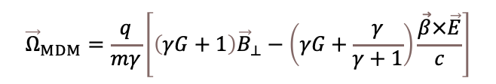
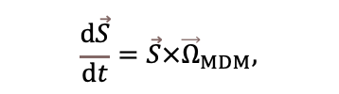


General equations
Deuteron case $G<0$
Senichev ed.
${\vec{Ω}}_{MDM}^{wf}$= $\frac{q}{mγ}$ $\left(γG+1\right){\vec{B}}_{⊥}$
$${\vec{B}}_{arc}$$
$$\vec{p}$$
Spin MDM rotation
$$\vec{s}$$
$${\vec{B}}_{WF}$$
$$\vec{E}$$
$$\vec{p}×{\vec{B}}_{arc}$$
$$\vec{p}$$
$$\frac{d\vec{S}}{dt}=\vec{S}×{\vec{Ω}}_{MDM},$$
arc
$${\vec{Ω}}_{MDM}=\frac{q}{mγ}\left[\left(γG+1\right){\vec{B}}_{⊥}−\left(γG+\frac{γ}{γ+1}\right)\frac{\vec{β}×\vec{E}}{c}\right]$$
$$\vec{s}$$
$${\vec{Ω}}_{MDM} =\frac{q}{mγ}{γG\vec{B}}_{⊥}=\frac{q}{mγ}{γ∙−\left|G_{d}\right|\vec{B}}_{⊥}$$
$$\vec{p}$$
Relative spin
$$\vec{p}$$
${\vec{Ω}}_{MDM}^{wf}$= $\frac{q}{mγ}$ $\left[−\left(γG+\frac{γ}{γ+1}\right)\frac{\vec{β}×\vec{E}}{c}\right]$
$${\vec{Ω}}_{MDM}^{arc}=\frac{q}{mγ}{γG\vec{B}}_{⊥}$$
$$\vec{s}$$

